Slide 1

REST API
By Aditya Pujari

Slide 2
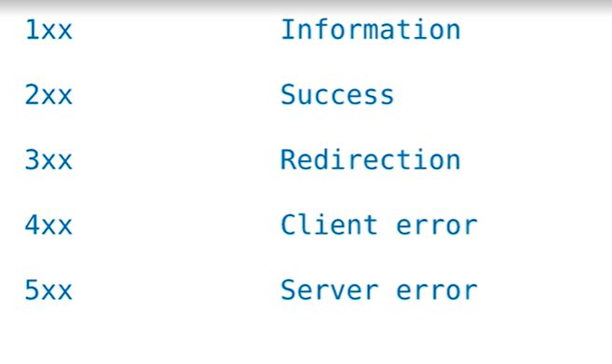
Types of Status Codes:

Slide 3
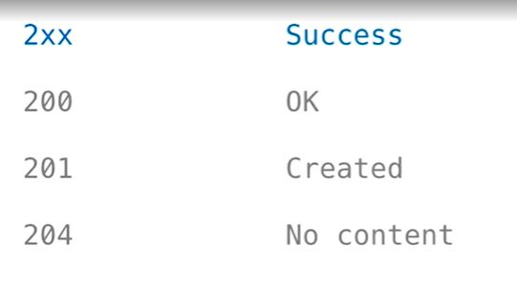
Types of Status Codes:

Slide 4
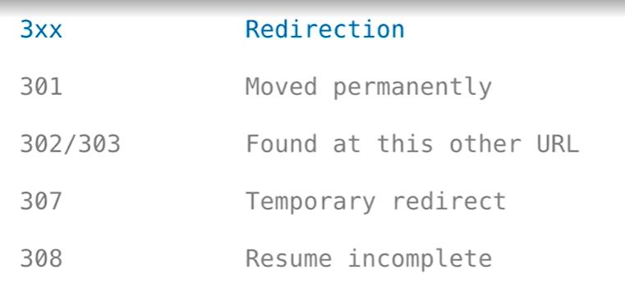
Types of Status Codes:

Slide 5
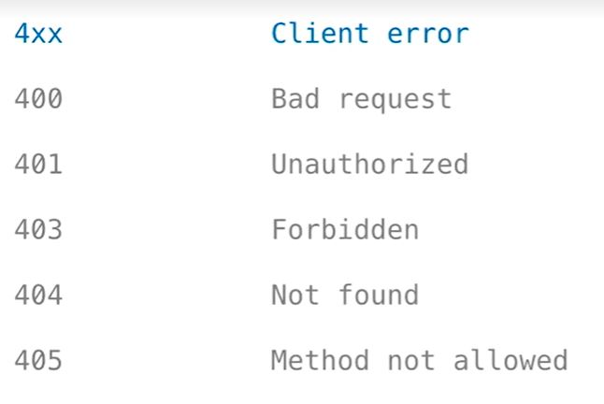
Types of Status Codes:

Slide 6
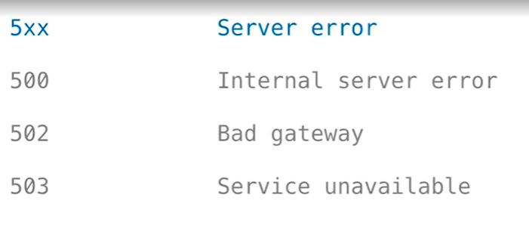
Types of Status Codes:

Slide 7
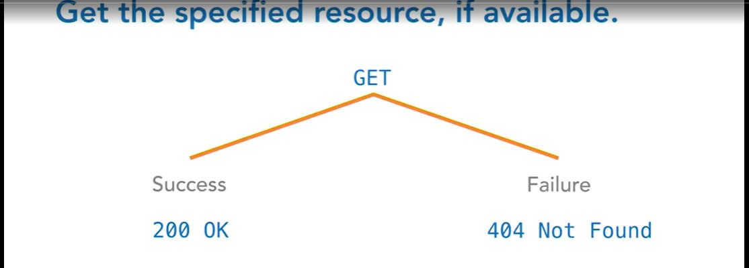
Types of Requests:

Slide 8
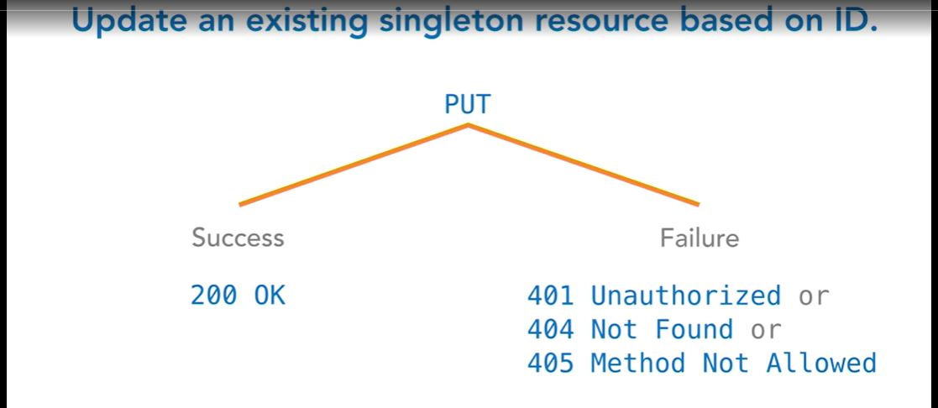
Types of Requests:

Slide 9
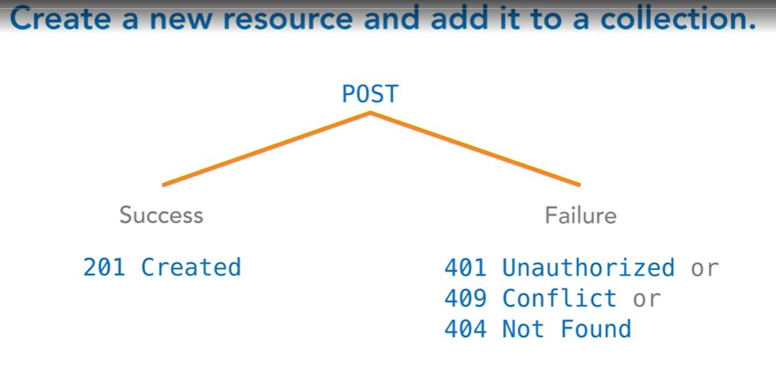
Types of Requests:

Slide 10
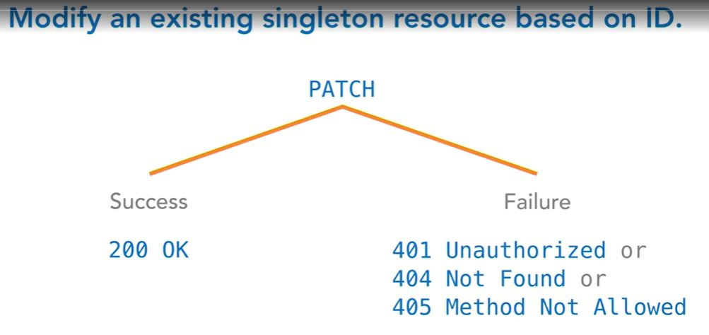
Types of Requests:

Slide 11
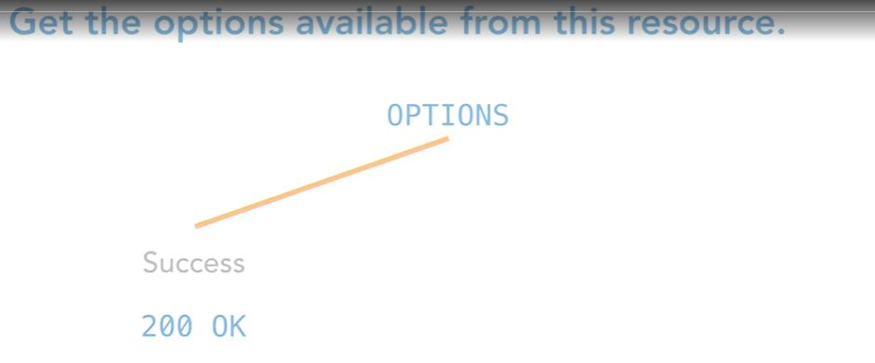
Types of Requests:

Slide 12
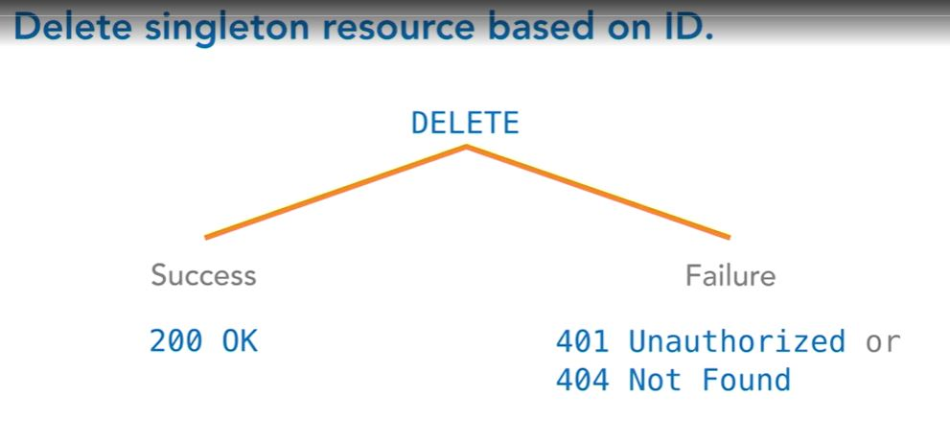
Types of Requests:

Slide 13
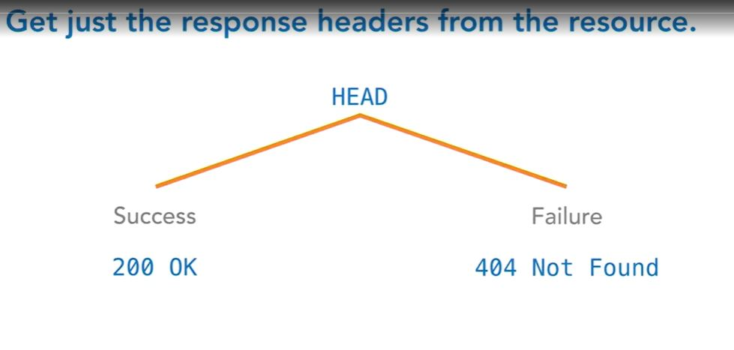
Types of Requests:

Slide 14
Thank you..!!
- Aditya Pujari

